Slide 1

Demystifying T1-MRI to FDG¹⁸-PET Image Translation via Representational Similarity
Chia-Hsiang Kao, Yong-Sheng Chen, Li-Fen Chen, and Wei-Chen Chiu
National Yang Ming Chiao Tung University, Taiwan
Student Travel Award in 24th International Conference on Medical Image Computing and Computer Assisted Intervention (MICCAI)
Presenter: Chia-Hsiang Kao
Supervisor: Chiu-Ming Ho, M.D., Ph.D.
Notes:
大家好，我是subintern高家祥。
上周在和何照明醫師討論後，我們決定在晨會上跟大家分享我這篇人工智慧主題的論文，也期待讓大家更了解不同取向的研究方式。
這篇論文在去年九月被醫學影像會議MICCAI接受，目前也正準備投稿到期刊。
這是我去年到交通大學交換一年的第一篇論文。

Slide 2
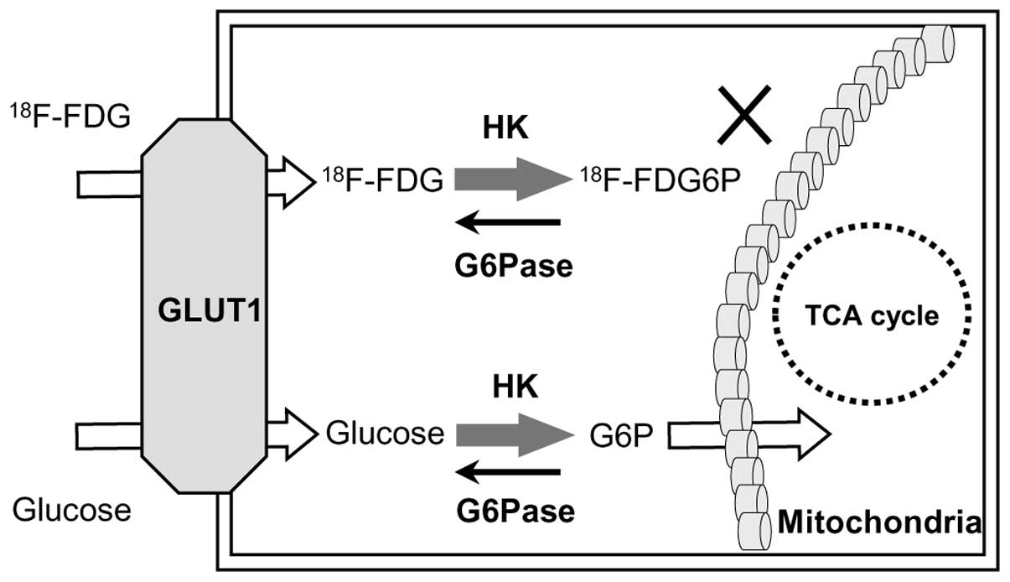
Introduction FDG-PET has been extensively used to as a functional imaging to study brain.
higher FDG update → higher metabolic activity
Notes:
臨床上與研究上，PET被視為是一種功能性的造影技術。
FDG-PET的成像原理是透過注射含同位素的葡萄糖FDG。因為活躍的細胞會吸收與代謝較多的FDG，因此在造影上較亮。像是腫瘤

Slide 3
Introduction FDG-PET has been extensively used to as a functional imaging to study brain.
Oncology
Neurology
Cardiology
Psychiatry
Study of pain
Resting stage functions
higher FDG update → higher metabolic activity
Notes:
目前在腫瘤科，神經科，心臟科以及精神科使用。
北榮的謝仁俊指導老師也曾用MRI和PET來研究過痛覺。

Slide 4
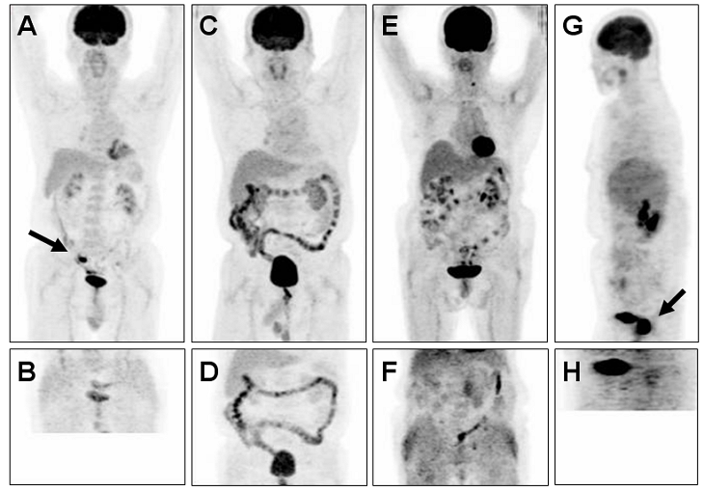
Introduction FDG-PET has been extensively used to as a functional imaging to study brain.
PET imaging requires an intravenous injection of 350–750 MBq ¹⁸F-FDG (or 4 MBq per kg BW).
若每秒有一個原子衰變，其放射性活度即為1貝克勒(Bq)。
例如，一克的鐳-226放射性活度有37000 MBq(百萬貝克勒)。
JAIF (9/20 2011 Earthquake-report 211: A new plan set to reduce radiation emissions
Notes:
然而，做一次的PET，大概等於接觸到0.01克的鐳。
而FDG的半衰期約為100分鐘，相等於是把0.01克的鐳放在身體裡維持100分鐘。
而且別忘記大腦和膀胱的FDG濃度會特別的高。

Slide 5
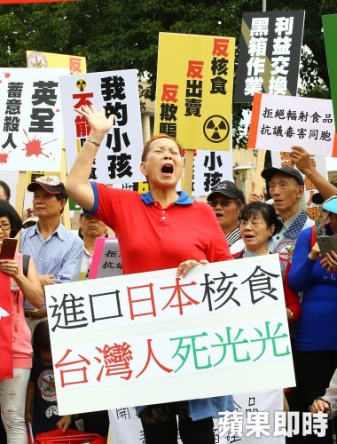
Introduction FDG-PET has been extensively used to as a functional imaging to study brain.
PET imaging requires an intravenous injection of 350–750 MBq ¹⁸F-FDG (or 4 MBq per kg BW).
根據東電，2011年9月，從核電廠釋出的放射性物質估計為200 MBq， 大約是三月事故發生初期放射線水平的四百萬分之一。
若每秒有一個原子衰變，其放射性活度即為1貝克勒。
例如，一克的鐳-226放射性活度有37000 MBq(百萬貝克勒)。
JAIF (9/20 2011 Earthquake-report 211: A new plan set to reduce radiation emissions
Notes:
根據東電，2011年9月，從核電廠釋出的放射性物質估計為200 MBq， 這數值比一次注射的PET數量要少約一半。

Slide 6
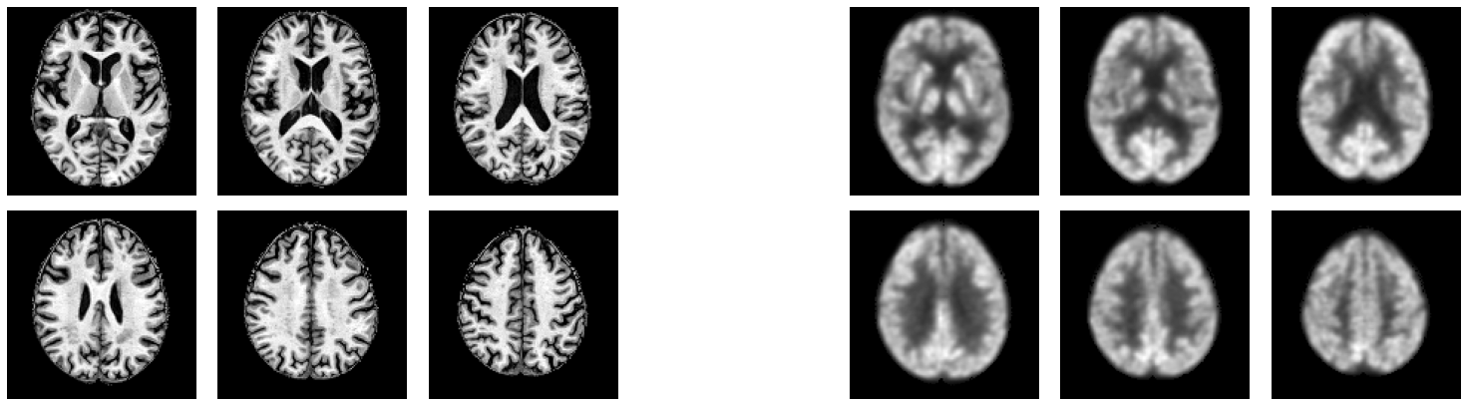
Introduction There is a growing research trend in using AI for cross-modality medical image translation.
T1-weighted Magnetic resonance imaging
(T1-MRI)
FDG¹⁸-positron emission tomography
(PET)
Principle |  |  | PET measures the glucose update ability of tissue to quantify the metabolic process.
Drawback |  |  | injection of radioactive tracer, high cost
DL-based image synthesis/translation
Nie, D. (2017), Pan, Y. (2018),
Sikka, A. (2018), Sun, H. (2019), Lan, H. (2020)
Notes:
於是，科學家就想，既然PET有放射性上的潛在威脅

Slide 7
Introduction There is a growing research trend in using AI for cross-modality medical image translation.
T1-weighted Magnetic resonance imaging
(T1-MRI)
FDG¹⁸-positron emission tomography
(PET)
Principle | MRI uses strong magnetic fields to identify the anatomical structure of the brain. |  | PET measures the glucose update ability of tissue to quantify the metabolic process.
Drawback | time consuming, high cost |  | injection of radioactive tracer, high cost
DL-based image synthesis/translation
Nie, D. (2017), Pan, Y. (2018),
Sikka, A. (2018), Sun, H. (2019), Lan, H. (2020)
Notes:
那我們能不能使用較安全的T1-MRI影像，來獲得相對應的PET影像

Slide 8
Introduction There is a growing research trend in using AI for cross-modality medical image translation.
T1-weighted Magnetic resonance imaging
(T1-MRI)
FDG¹⁸-positron emission tomography
(PET)
Principle | MRI uses strong magnetic fields to identify the anatomical structure of the brain. |  | PET measures the glucose update ability of tissue to quantify the metabolic process.
Drawback | time consuming, high cost |  | injection of radioactive tracer, high cost
Deep learning-based image translation
Nie, D. (2017), Pan, Y. (2018),
Sikka, A. (2018), Sun, H. (2019), Lan, H. (2020)
Notes:
從2017年開始，在深度學習領域開始有科學家進行這樣的嘗試，並有所斬獲。

Slide 9
Introduction There is a growing research trend in using AI for cross-modality medical image translation.
Wait a moment!
What is image translation?
T1-weighted Magnetic resonance imaging
(T1-MRI)
FDG¹⁸-positron emission tomography
(PET)
Principle | MRI uses strong magnetic fields to identify the anatomical structure of the brain. |  | PET measures the glucose update ability of tissue to quantify the metabolic process.
Drawback | time consuming, high cost |  | injection of radioactive tracer, high cost
Deep learning-based image translation
Nie, D. (2017), Pan, Y. (2018),
Sikka, A. (2018), Sun, H. (2019), Lan, H. (2020)
Notes:
但在這之前，老師們可能會想，什麼是image translation呢?

Slide 10
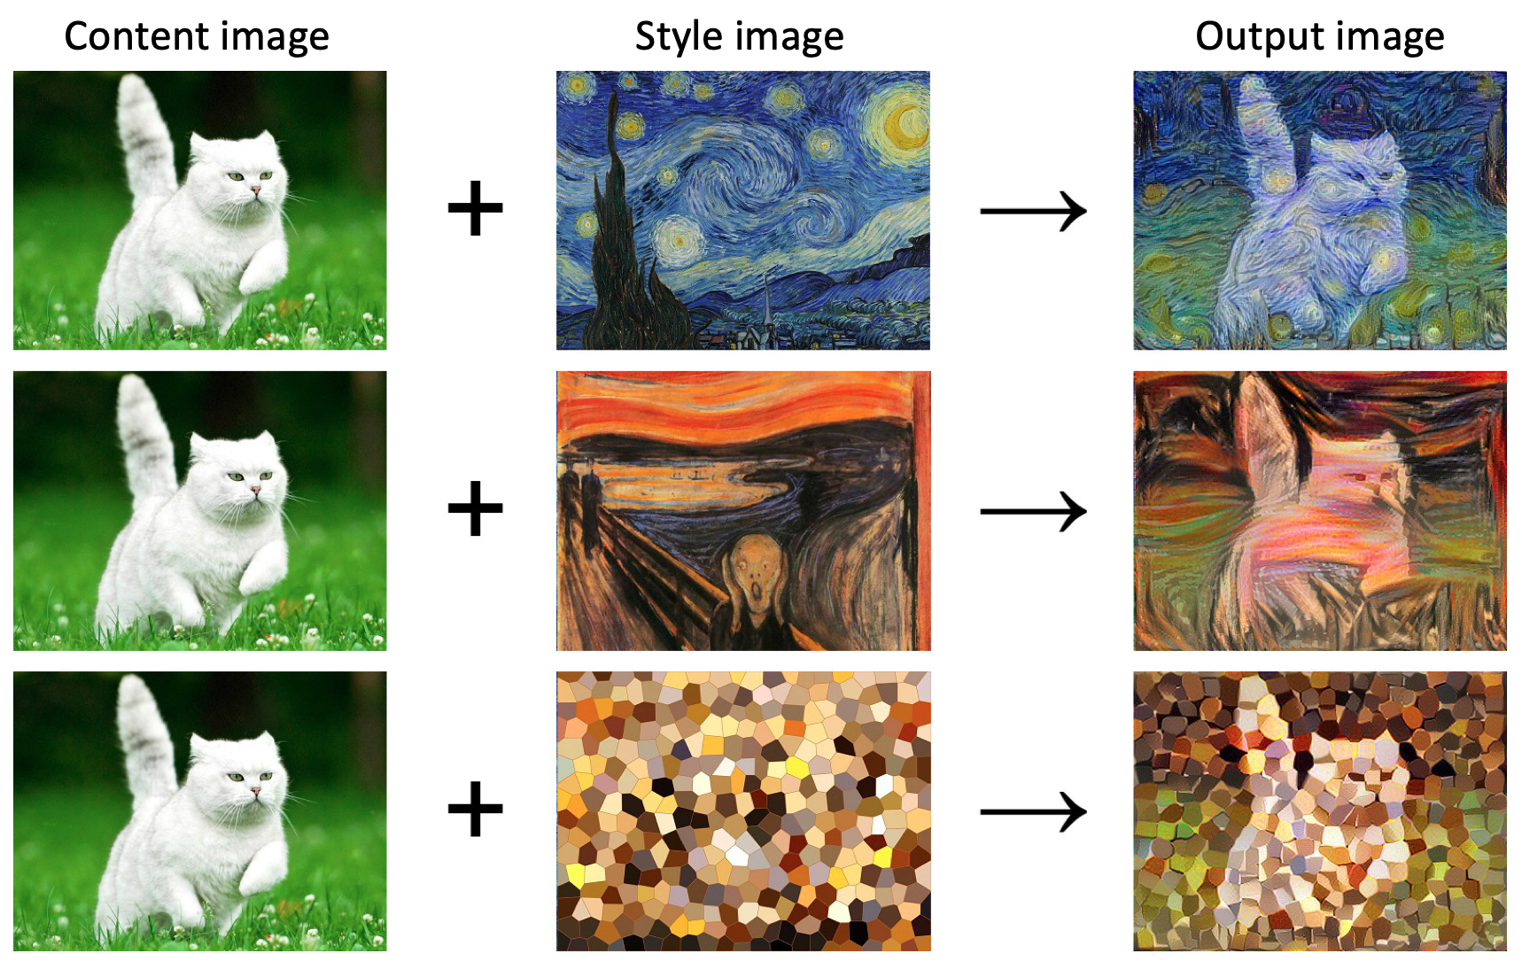
Preliminary Nowadays, we can translate images into different styles.
Wait a moment!
What is image translation?
Notes:
所謂的image translation是指我們將影像轉變成不同風格的影像。
例如，對於同一隻左排的貓，我們在給予不同的風格元素後，可以

Slide 11
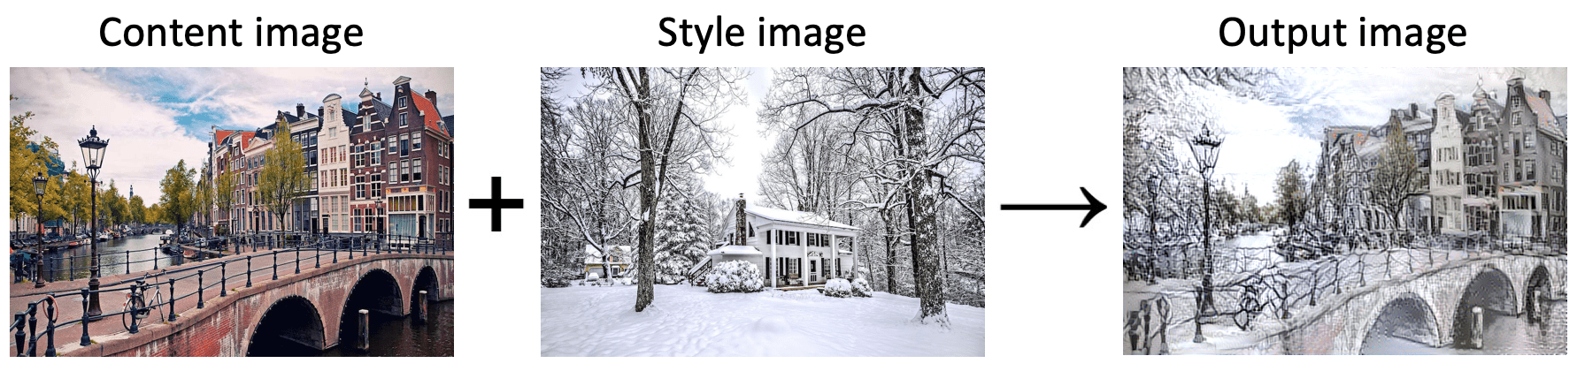
Preliminary Nowadays, we can translate images into different styles.
Wait a moment!
What is image translation?
Notes:
或是把春天的景色，加入冬天的風格，變成冬天的景色

Slide 12
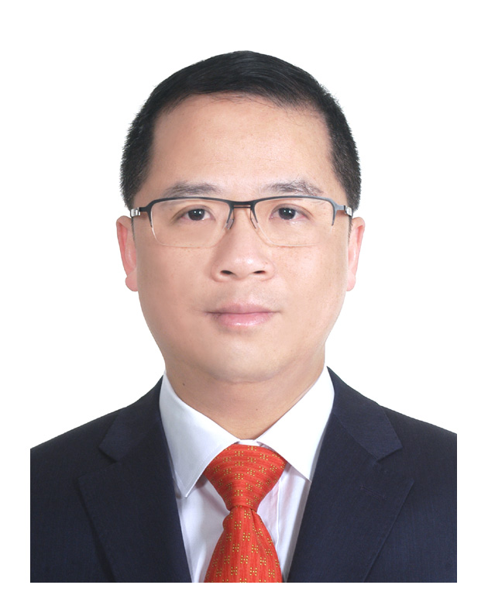
Preliminary Nowadays, we can translate images into different styles.
Wait a moment!
What is image translation?
Notes:
或是我們可以把何照明老師的大頭照，

Slide 13
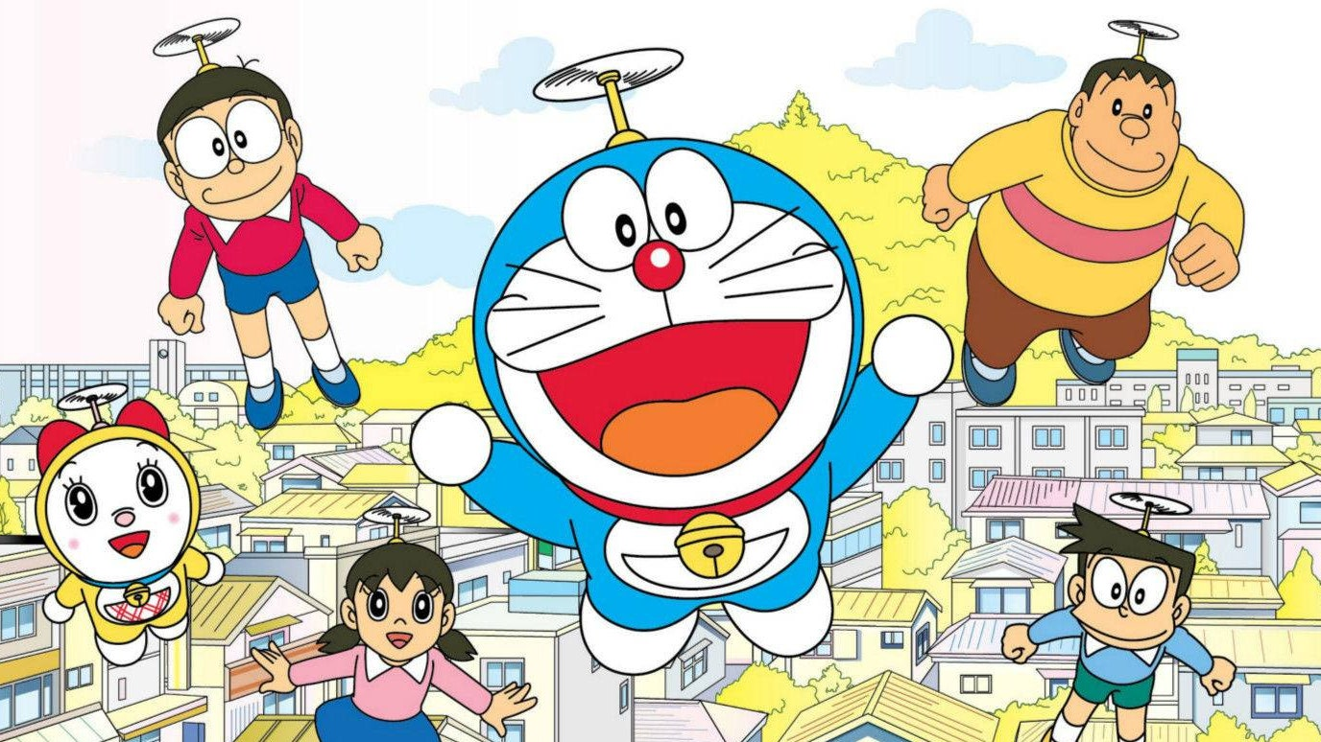
Preliminary Nowadays, we can translate images into different styles.
Wait a moment!
What is image translation?

Slide 14
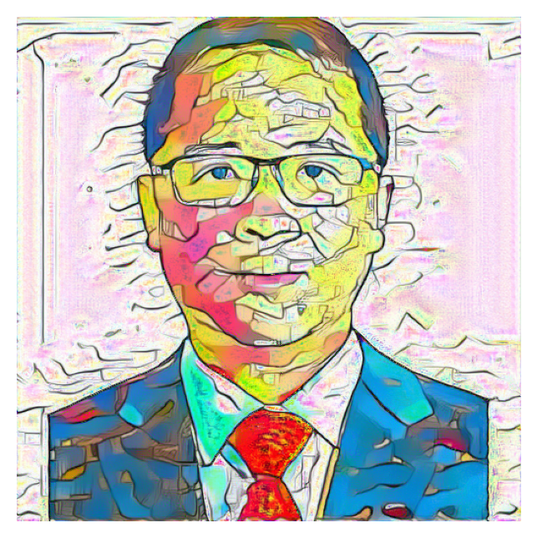
Preliminary Nowadays, we can translate images into different styles.
Wait a moment!
What is image translation?

Slide 15
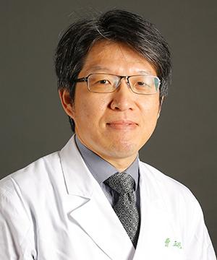
Preliminary Nowadays, we can translate images into different styles.
Wait a moment!
What is image translation?

Slide 16
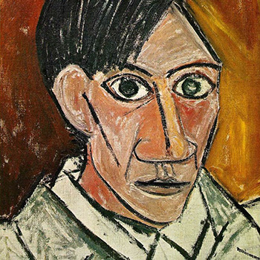
Preliminary Nowadays, we can translate images into different styles.
Wait a moment!
What is image translation?
Self-Portrait - Pablo Picasso (1907)

Slide 17
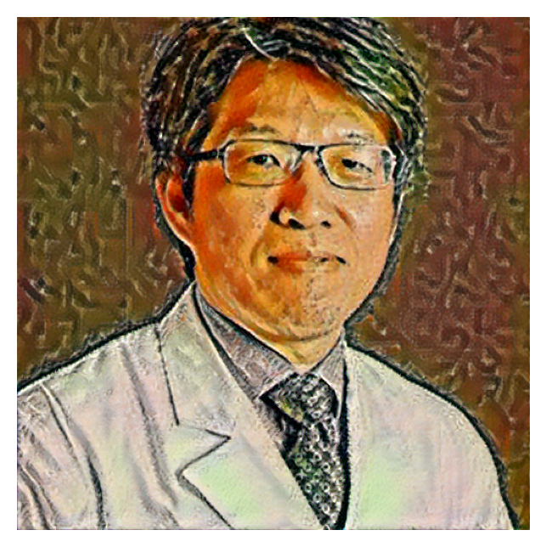
Preliminary Nowadays, we can translate images into different styles.
Wait a moment!
What is image translation?
Self-Portrait - Pablo Picasso (1907)
Notes:
這個，就是image translation

Slide 18
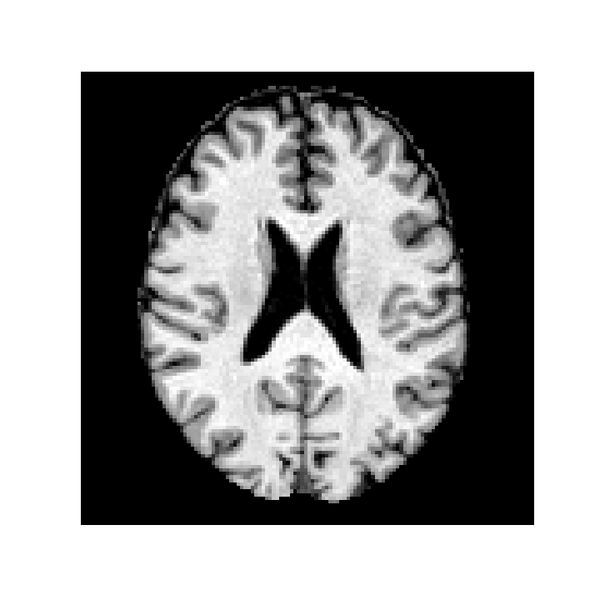
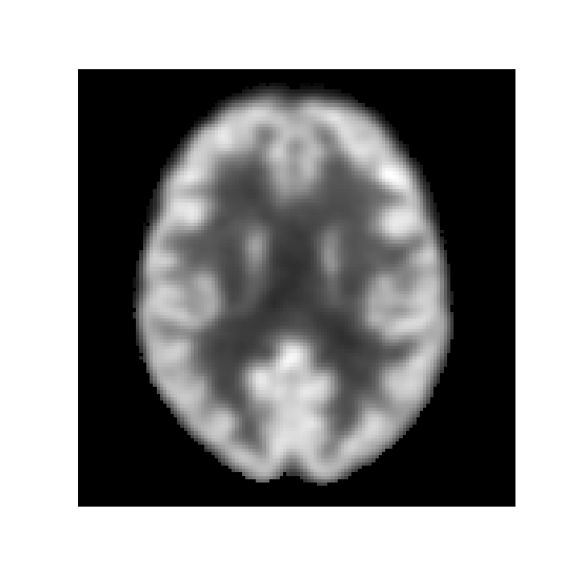
Introduction What if we can transfer T1-MRI images to FDG-PET images?
Wait a moment!
What is image translation?
Any PET image
(to indicate the “PET” style)
T1-MRI images of a patient
FDG-PET images of a patient
Notes:
因此，拉回正題，過去的研究把醫學影像轉換的過程，變成一種Image translation的問題

Slide 19
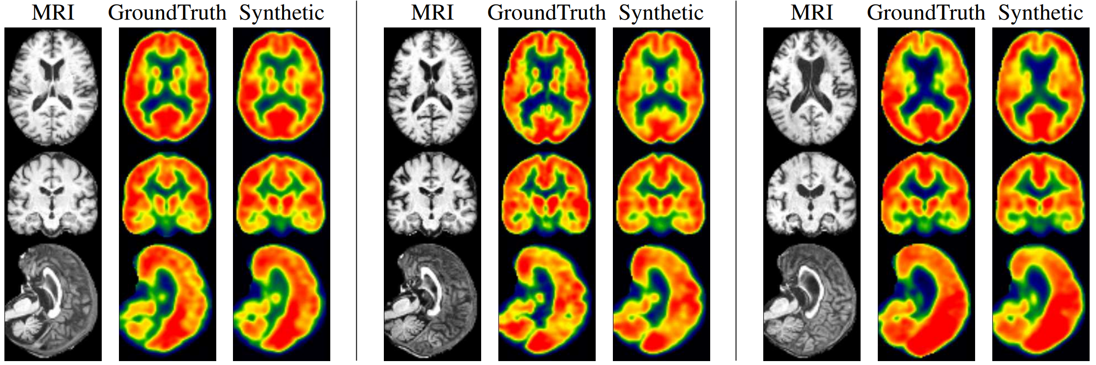
Introduction There is a growing research trend in using AI for cross-modality medical image translation.
MRI real PET Prediction
Synthetic images are meaningful for subjects in both extremes of disease spectrum.
Left: CN. Middle: MCI. Right: AD. The generated PET images show consistency of hypometabolism (less red, more yellow) with the ground truth image.
Sun, H., Mehta, R., Zhou, H. H., Huang, Z., Johnson, S. C., Prabhakaran, V., & Singh, V. (2019). Dual-glow: Conditional flow-based generative model for modality transfer. CVPR (pp. 10611-10620).
Notes:
在這些研究裡面，他們獲得的結果和real PET十分一致

Slide 20
Introduction There is a growing research trend in using AI for cross-modality medical image translation.
MAE: < 1%
PSNR: 29.56
SSIM: 0.898
MRI real PET Synthetic
MRI real PET Prediction
MRI real PET Prediction
Synthetic images are meaningful for subjects in both extremes of disease spectrum.
Left: CN. Middle: MCI. Right: AD. The generated PET images show consistency of hypometabolism (less red, more yellow) with the ground truth image.
Sun, H., Mehta, R., Zhou, H. H., Huang, Z., Johnson, S. C., Prabhakaran, V., & Singh, V. (2019). Dual-glow: Conditional flow-based generative model for modality transfer. CVPR (pp. 10611-10620).
Notes:
他們的結果，不管是訂質或是定量來看，都意味著高度的成熟性

Slide 21
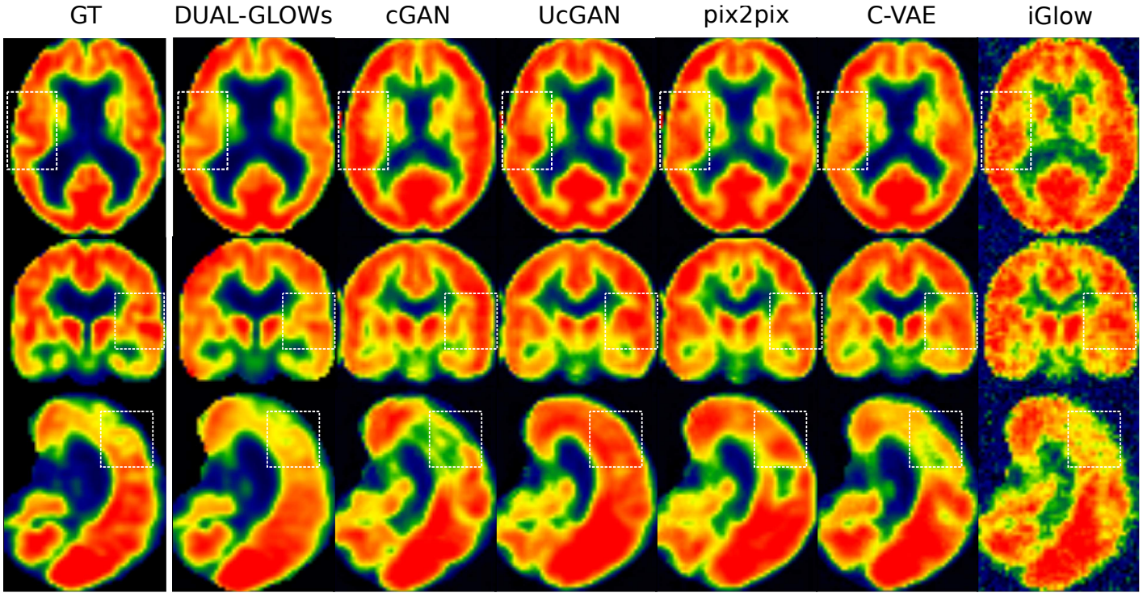
Introduction There is a growing research trend in using AI for cross-modality medical image translation.
Latest
Conventional
Sun, H., Mehta, R., Zhou, H. H., Huang, Z., Johnson, S. C., Prabhakaran, V., & Singh, V. (2019). Dual-glow: Conditional flow-based generative model for modality transfer. CVPR (pp. 10611-10620).

Slide 22
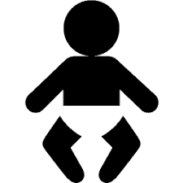

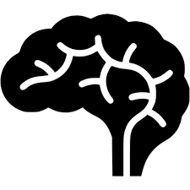
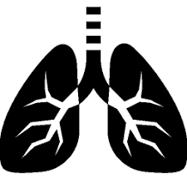



Introduction However, there are several major concerns when it comes to clinical applications.
Robustness to distributional biases (population, organs, diseases).
Robustness to systemic biases (scanning devices and protocols, preprocessing techniques).
Robustness to out-of-distribution cases, noise and adversarial perturbations.

Slide 23
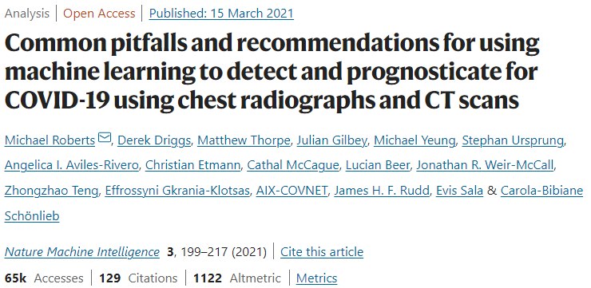
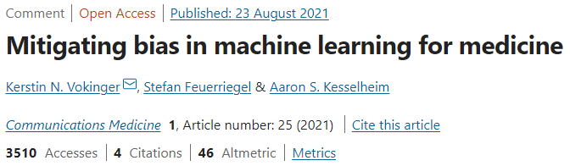
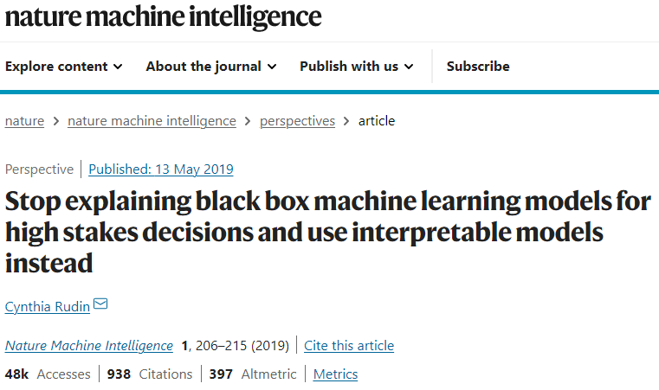
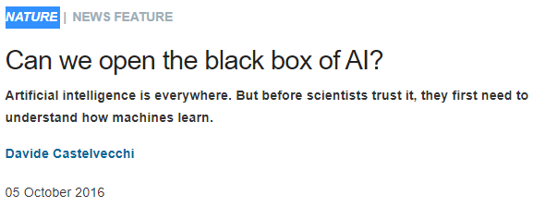
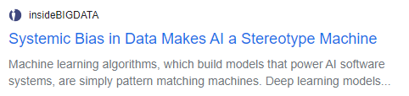
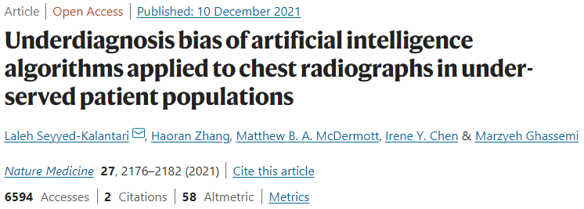
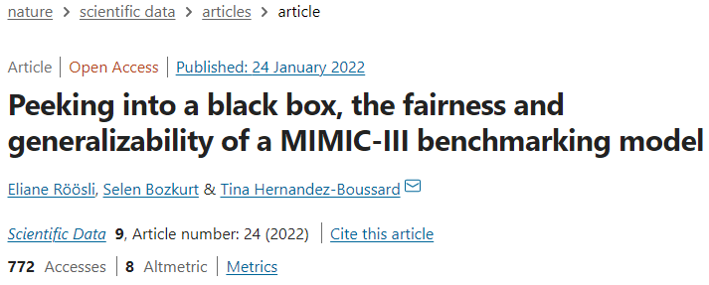
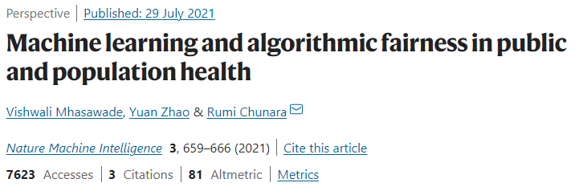
Introduction Even more, deep learning models remain black-box for most AI scientists.

Slide 24
Motivation We don’t know how deep learning models translate T1-MRI images to FDG-PET images?
Can it be applied to different organs and to various diseases?
What are the limitations of this technique?
Notes:
然而，在一年前我讀到這些研究時，我發現沒有人去討論為什麼人工智慧可以把T1-MRI影像轉換成PET影像
這個技術有沒有限制呢?
他可以做用到不同器官，或是可以做用到腫瘤、發炎上嗎?
這兩個都是重要的問題，而這些問題的本質是「深度學習模型是如何進行影像轉換的」

Slide 25
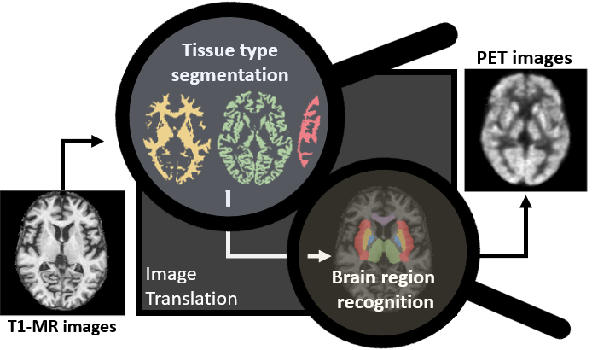
Motivation We don’t know how deep learning models translate T1-MRI images to FDG-PET images?
?
?
Notes:
然而，在一年前我讀到這些研究時，我發現沒有人去討論為什麼人工智慧可以把T1-MRI影像轉換成PET影像
這個技術有沒有限制呢?
他可以做用到不同器官，或是可以做用到腫瘤、發炎上嗎?
這兩個都是重要的問題，而這些問題的本質是「深度學習模型是如何進行影像轉換的」

Slide 26
Motivation We don’t know how deep learning models translate T1-MRI images to FDG-PET images?

Slide 27
Motivation Statement of purpose
What is known?
Deep learning models are able to transform images of a T1-MRI style to an FDG-PET style.
What is not known?
We do not know how this transformation works.

Slide 28
Motivation Statement of purpose
What is known?
Deep learning models are able to transform images of a T1-MRI style to an FDG-PET style.
What is not known?
We do not know how this transformation works.
Main challenge.
Deep learning models contain tens of millions of parameters. As a result, it is hard to understand the inner working mechanism of these models.

Slide 29
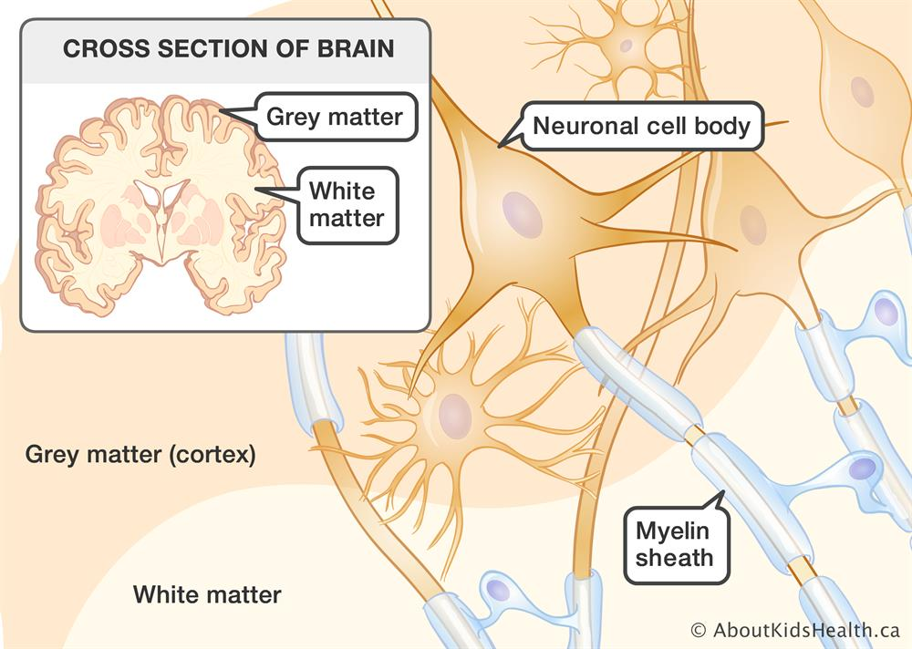
Motivation The basic imaging principles of T1-MRI and FDG-PET.
T1-MRI | FDG-PET
Gray, because of moderate amount of water. | White, because consume much glucose to generate energy.
White, because of the lipids in the myelinated axon. | Black, because it does not contain mitochondria.
Notes:
有沒有可能，深度學習模型其實先辨識不同的腦組織，接著，把灰質賦予較高的數值，並把白質賦予較低的數值，然後加權相加之後獲得PET影像

Slide 30
Motivation Statement of purpose
What is known?
Deep learning models are able to transform images of a T1-MRI style to an FDG-PET style.
What is not known?
We do not know how this transformation works.
Main challenge.
Deep learning models contain tens of millions of parameters. As a result, it is hard to understand the inner working mechanism of these models.
Intuition.
Does the model segment/extract brain tissue type information during the translation process?

Slide 31
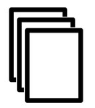
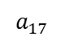
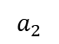
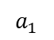
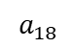
Intuition Does the model segment/extract brain tissue type information during the translation process?
Black-box transformation process
$$a_{1}$$
$$a_{2}$$
$$a_{17}$$
$$a_{18}$$
Notes:
讓我舉例一夏，現在我們有一個深度學習模型

Slide 32
Intuition Does the model segment/extract brain tissue type information during the translation process?
Black-box transformation process
$$a_{1}$$
$$a_{2}$$
$$a_{17}$$
$$a_{18}$$
Notes:
我們猜測，這個模型的作用是

Slide 33
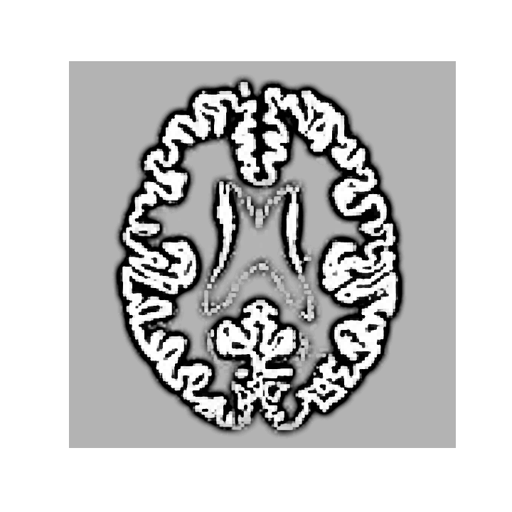
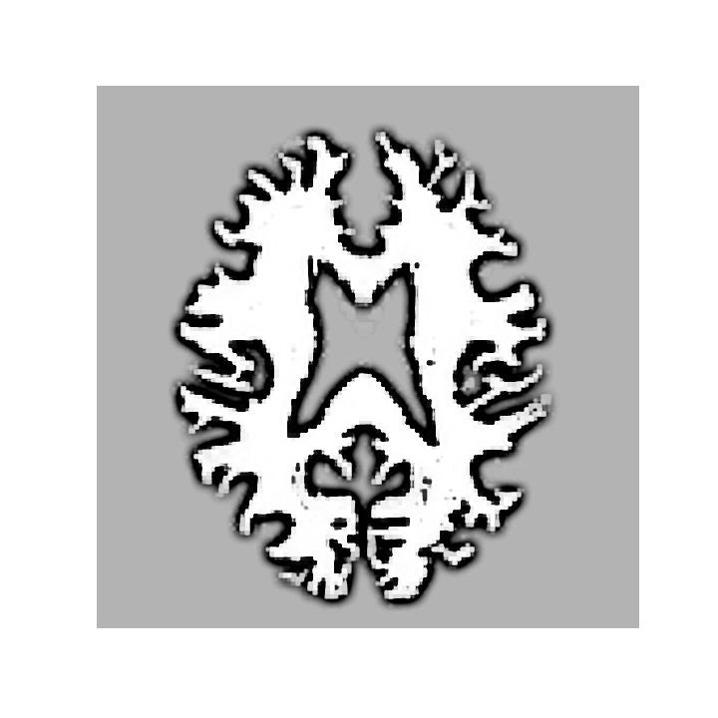
Intuition Does the model segment/extract brain tissue type information during the translation process?
Black-box transformation process
$$a_{1}$$
$$a_{2}$$
$$a_{17}$$
$$a_{18}$$
Segmentation
Notes:
根據組織類型，切出不同的影像

Slide 34
Intuition Does the model segment/extract brain tissue type information during the translation process?
Black-box transformation process
$$a_{1}$$
$$a_{2}$$
$$a_{17}$$
$$a_{18}$$
x 0.9
+
x 0.1
Segmentation
Weighting, blurring and summation
Notes:
接著，按照組織特性，來合成出PET影像。
這是個很直覺的想法與猜測，但是在人工智慧領域哩，這是第一篇提出這樣猜測的論文。

Slide 35
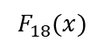
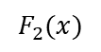
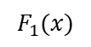
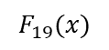
Method Deep learning model is a couple of non-linear transformation functions.
$$F_{1}(x)$$
$$F_{2}(x)$$
$$F_{18}(x)$$
$$F_{19}(x)$$
Black-box transformation process
$$a_{1}$$
$$a_{2}$$
$$a_{17}$$
$$a_{18}$$
Notes:
那實務上，我們要如何進行實驗呢?
首先，一個深度學習模型，本質上可以視為是許多非線性轉換的函數F的耦合

Slide 36
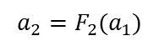
Method Deep learning model is a couple of non-linear transformation functions.
High-dimensional data
$$F_{1}(x)$$
$$F_{2}(x)$$
$$F_{18}(x)$$
$$F_{19}(x)$$
$$a_{1}$$
$$a_{2}$$
$$a_{17}$$
$$a_{18}$$
$$a_{2}=F_{2}(a_{1})$$
Notes:
這邊，我們稱呼每個中介的非線性轉換函數的輸出值為a，這邊的a都是高維度的資料。
舉例來說，我們有$a_{2}=F_{2}(a_{1})$

Slide 37
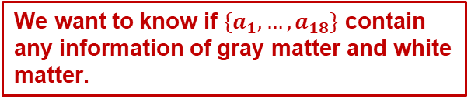
Method Deep learning model is a couple of non-linear transformation functions.
High-dimensional data
$$F_{1}(x)$$
$$F_{2}(x)$$
$$F_{18}(x)$$
$$F_{19}(x)$$
$$a_{1}$$
$$a_{2}$$
$$a_{17}$$
$$a_{18}$$
We want to know if $\{a_{1},…,a_{18}\}$ contain any information of gray matter and white matter.
Notes:
我們希望了解這些高維度資料是否包含灰質和白質的資訊

Slide 38
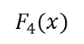
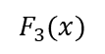
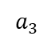
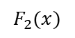
Method Compute the similarity between the intermediate (transformed) data and the GM/WM data.
$$F_{1}(x)$$
$$F_{2}(x)$$
$$F_{3}(x)$$
$$F_{4}(x)$$
$$a_{1}$$
$$a_{2}$$
$$a_{3}$$
Notes:
具體上我們會如此進行

Slide 39
Method Compute the similarity between the intermediate (transformed) data and the GM/WM data.
$$F_{1}(x)$$
$$F_{2}(x)$$
$$F_{3}(x)$$
$$F_{4}(x)$$
$$a_{1}$$
$$a_{2}$$
$$a_{3}$$
Use existing (standard) method to get the gray matter maps

Slide 40
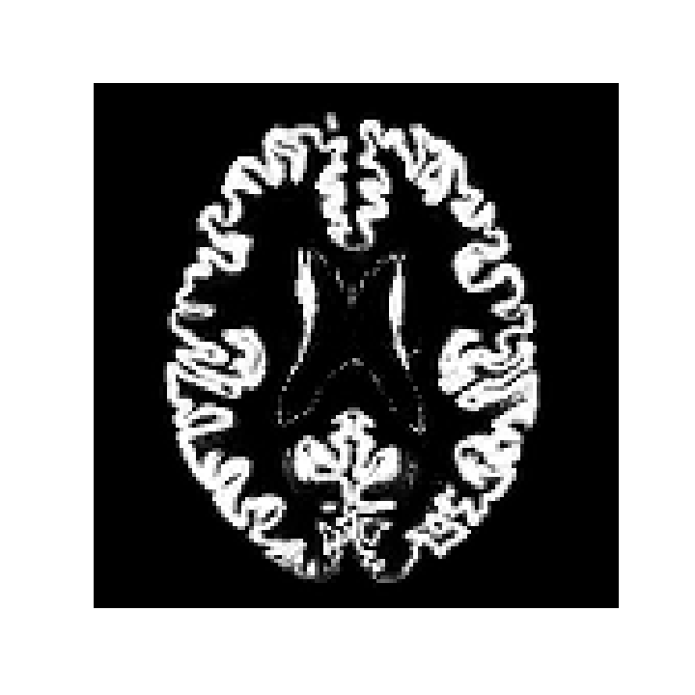
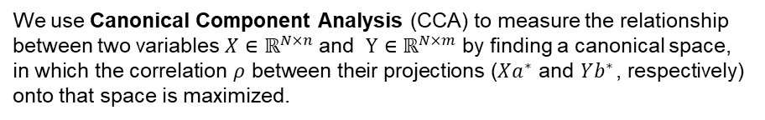
Method Compute the similarity between the intermediate (transformed) data and the GM/WM data.
$$F_{1}(x)$$
$$F_{2}(x)$$
$$F_{3}(x)$$
$$F_{4}(x)$$
$$a_{1}$$
$$a_{2}$$
$$a_{3}$$
15%
19%
65%
We use Canonical Component Analysis (CCA) to measure the relationship between two variables $X∈ℝ^{N×n}$ and $Y∈ℝ^{N×m}$ by finding a canonical space, in which the correlation $ρ$ between their projections ($Xa^{∗}$ and $Yb^{∗}$, respectively) onto that space is maximized.

Slide 41
Method Compute the similarity between the intermediate (transformed) data and the GM/WM data.
$$F_{1}(x)$$
$$F_{2}(x)$$
$$F_{3}(x)$$
$$F_{4}(x)$$
$$a_{1}$$
$$a_{2}$$
$$a_{3}$$
15%
19%
65%
How to interpret the meaning of CCA similarity?
0% → independent, (PET and Picasso’s paintings)
20% → the similarity between PET and T1-MRI
100% → same, up to linear transformation
We use Canonical Component Analysis (CCA) to measure the relationship between two variables $X∈ℝ^{N×n}$ and $Y∈ℝ^{N×m}$ by finding a canonical space, in which the correlation $ρ$ between their projections ($Xa^{∗}$ and $Yb^{∗}$, respectively) onto that space is maximized.

Slide 42
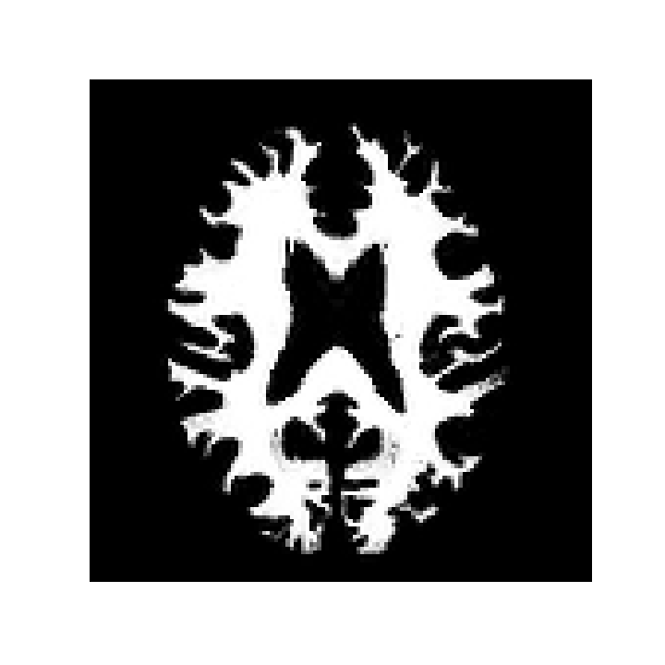
Method Compute the similarity between the intermediate (transformed) data and the GM/WM data.
$$F_{1}(x)$$
$$F_{2}(x)$$
$$F_{3}(x)$$
$$F_{4}(x)$$
$$a_{1}$$
$$a_{2}$$
$$a_{3}$$
15%
19%
65%
85%
89%
85%

Slide 43
Method Compute the similarity between the intermediate (transformed) data and the GM/WM data.
$$F_{1}(x)$$
$$F_{2}(x)$$
$$F_{3}(x)$$
$$F_{4}(x)$$
$$a_{1}$$
$$a_{2}$$
$$a_{3}$$
15%
19%
65%
85%
89%
85%
20%
50%
90%

Slide 44

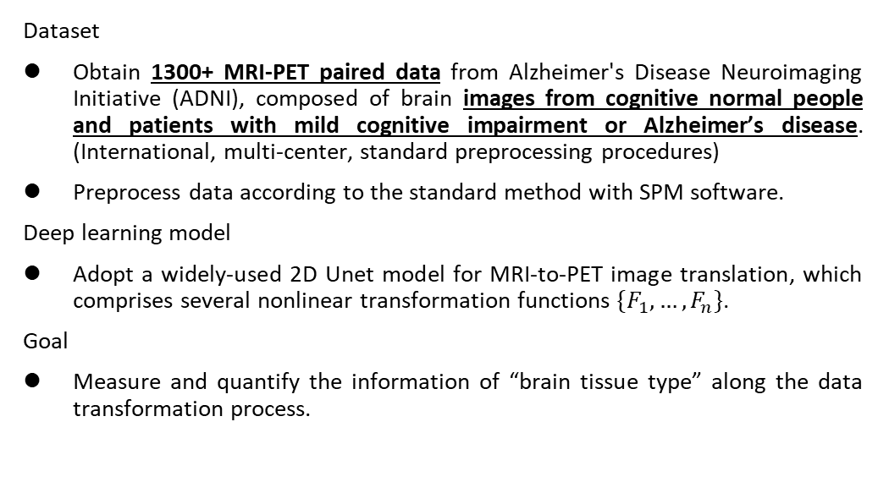
Method d
Dataset
Obtain 1300+ MRI-PET paired data from Alzheimer's Disease Neuroimaging Initiative (ADNI), composed of brain images from cognitive normal people and patients with mild cognitive impairment or Alzheimer’s disease. (International, multi-center, standard preprocessing procedures)
Preprocess data according to the standard method with SPM software.
Deep learning model
Adopt a widely-used 2D Unet model for MRI-to-PET image translation, which comprises several nonlinear transformation functions $\{F_{1},…,F_{n}\}$.
Goal
Measure and quantify the information of “brain tissue type” along the data transformation process.

Slide 45

Results Brain tissues are segmented in the early encoding stage of image translation.
…
Notes:
橫軸是18 個非線性轉換函數
縱軸是計算出的similarity

Slide 46
Results Brain tissues are segmented in the early encoding stage of image translation.
…
Notes:
這邊，先讓我們聚焦到藍色的線上，藍色的線，是T1-MRI跟高維度資料所計算出的CCA similarity。
可以發現約為0.8左右

Slide 47
Results Brain tissues are segmented in the early encoding stage of image translation.
…
Notes:
接著，讓我們聚焦到橘色的線上，橘色的線，是PET跟高維度資料所計算出的CCA similarity。
可以發現剛開始為0.2，並逐漸升高，最終逐步高升到接近於1
在有了這些印象之後，我們來看我們更重要的結果

Slide 48

Results Brain tissues are segmented in the early encoding stage of image translation.
…
Notes:
現在，讓我們聚焦到紅色的線上，紅色的線，是白質圖片跟高維度資料所計算出的CCA similarity。
可以發現一直維持在約0.7的位置

Slide 49
Results Brain tissues are segmented in the early encoding stage of image translation.
…
Notes:
接著，讓我們聚焦到綠色的線上，綠色的線，是灰質圖片跟高維度資料所計算出的CCA similarity。
可以發現剛開始約為0.3，之後急速上升，而後又慢慢下降。

Slide 50
Results Brain tissues are segmented in the early encoding stage of image translation.
The model segments out the gray matter tissue during the transformation process.
…
Notes:
這些結果內我們可以發現，深度學習模型內部本身的白質含量就很高，而在前期逐步提升灰質資訊的含量。

Slide 51

Results Brain tissues are segmented in the early encoding stage of image translation.
(Early stage)
When the model contains more gray matter information, it also contains more FDG-PET information.
…
Notes:
我們也可以把灰質和PET的曲線放在一起比較，如圖所示。我們發現在前半段時，高維度資料所含有的PET的資訊和灰質資訊的變化是一致的。
我們的解讀是，在模型的前幾個轉換函數裡頭，當模型擁有較多的灰質資訊時，其PET的資訊也會逐漸上升。

Slide 52
Results Brain tissues are segmented in the early encoding stage of image translation.
This does not explain the disparity at the late transformation stage
…
Notes:
然而，在後半段，我們發現綠色曲線下降，也就是高維度資料所擁有的灰質資訊不斷下降。
但同時高維度資料所擁有的PET資訊卻持續上升。
這時，我們又想，是誰提供了多的PET資訊呢?

Slide 53


Hypothesis Deep learning models learn to segment brain regions.
Higher uptake regions in NC
Least altered regions during aging
Regions of hypometabolism in AD
Brain: normal variations and benign findings in fluorodeoxyglucose-PET/computed tomography imaging. (PET Clin. 2014)
Voxel-based mapping of brain gray matter volume and glucose metabolism profiles in normal aging. (Neurobiology of Aging. 2007)
Brain PET in the diagnosis of Alzheimer's disease. (Clin Nucl Med. 2014)

Slide 54


Method Compute the similarity between the intermediate (transformed) data and the GM/WM data.
$$F_{1}(x)$$
$$F_{2}(x)$$
$$F_{3}(x)$$
$$F_{4}(x)$$
$$a_{1}$$
$$a_{2}$$
$$a_{3}$$
Use existing (standard) method to get the brain region maps.
15%
19%
65%
85%
89%
85%

Slide 55

Results Brain regions are identified in the decoding stage of translation.
Notes:
現在，我們跑一樣的CCA similarity，但是計算的對象從原本的灰質、白質、MRI和PET，變成是每個腦區的圖片。

Slide 56
Results Brain regions are identified in the decoding stage of translation.
(Early stage)
Recognition of brain regions.
Notes:
一樣的，我們發現在影像轉換的前期，高維度資料所涵蓋的腦區資訊不斷上升

Slide 57
Results Brain regions are identified in the decoding stage of translation.
(Early stage)
Recognition of brain regions.
(Late stage)
Information of less contributory regions decreases.
Notes:
而在後期階段，高維度資料會捨棄掉不重要的腦區的資料，例如紅色、藍色曲線，或是紫色咖啡色曲線。
同時間，高維度資料仍然保持著Putamen和thalamus的腦區資訊。
簡言之，我們的分析結果支持我們的猜測。

Slide 58
Results a
We use representational similarity to verify our proposed hypotheses that the translation from T1-MR to PET images comprises the recognition of brain tissue types and the identification of brain regions.
Notes:
綜合以上，在本篇研究裡，我們使用CCA相似度來測量模型內部對腦組織以及腦區的資訊含量，並藉此觀察深度學習模型進行醫學影像轉換的方法。我們的結果顯示，XXXX。
在這樣的情況下，我們的研究明確指出，這樣的模型無法使用在大腦腫瘤，癲癇的病人上，也更無法使用到不同器官上。

Slide 59
A quick review

Slide 60
Introduction What if we can transfer T1-MRI images to FDG-PET images?
Wait a moment!
What is image translation?
Any PET image
(to indicate the “PET” style)
T1-MRI images of a patient
FDG-PET images of a patient
Notes:
因此，拉回正題，過去的研究把醫學影像轉換的過程，變成一種Image translation的問題

Slide 61
Introduction There is a growing research trend in using AI for cross-modality medical image translation.
MAE: < 1%
PSNR: 29.56
SSIM: 0.898
MRI real PET Synthetic
MRI real PET Prediction
MRI real PET Prediction
Synthetic images are meaningful for subjects in both extremes of disease spectrum.
Left: CN. Middle: MCI. Right: AD. The generated PET images show consistency of hypometabolism (less red, more yellow) with the ground truth image.
Sun, H., Mehta, R., Zhou, H. H., Huang, Z., Johnson, S. C., Prabhakaran, V., & Singh, V. (2019). Dual-glow: Conditional flow-based generative model for modality transfer. CVPR (pp. 10611-10620).
Notes:
他們的結果，不管是訂質或是定量來看，都意味著高度的成熟性

Slide 62
Intuition Does the model segment/extract brain tissue type information during the translation process?
Black-box transformation process
$$a_{1}$$
$$a_{2}$$
$$a_{17}$$
$$a_{18}$$
x 0.9
+
x 0.1
Segmentation
Weighting, blurring and summation
Notes:
接著，按照組織特性，來合成出PET影像。
這是個很直覺的想法與猜測，但是在人工智慧領域哩，這是第一篇提出這樣猜測的論文。

Slide 63
Results Brain tissues are segmented in the early encoding stage of image translation.
(Early stage)
When the model contains more gray matter information, it also contains more FDG-PET information.
This does not explain the disparity at the late transformation stage
…
Notes:
然而，在後半段，我們發現綠色曲線下降，也就是高維度資料所擁有的灰質資訊不斷下降。
但同時高維度資料所擁有的PET資訊卻持續上升。
這時，我們又想，是誰提供了多的PET資訊呢?

Slide 64
Results Brain regions are identified in the decoding stage of translation.
(Early stage)
Recognition of brain regions.
(Late stage)
Information of less contributory regions decreases.
Notes:
而在後期階段，高維度資料會捨棄掉不重要的腦區的資料，例如紅色、藍色曲線，或是紫色咖啡色曲線。
同時間，高維度資料仍然保持著Putamen和thalamus的腦區資訊。

Slide 65


Intuition Does the model segment/extract brain tissue type information during the translation process?
x 0.9
+
x 0.1
x 0.05
x 0.05
Notes:
接著，按照組織特性，來合成出PET影像。
這是個很直覺的想法與猜測，但是在人工智慧領域哩，這是第一篇提出這樣猜測的論文。

Slide 66
Results a
We use representational similarity to verify our proposed hypotheses that the translation from T1-MR to PET images comprises the recognition of brain tissue types and the identification of brain regions.

Slide 68
Limitation and future work ff
Dataset – organs, diseases, modalities (e.g., different radioactive tracers), machines.
Models – various deep learning models.
Measurement of similarity – curse of dimensionality.

